Slide 1
Reed Solomon (5,3)
Coder-Decoder in GF256
Prepared by Soner Yeşil
TÜBİTAK-BİLTEN
VLSI Design Group

Slide 2
Reed Solomon Coding
Storage Systems (Hard Disks, Compact Discs, DVD’s, Barcodes)
Wireless communications (Mobile phones, Microwave links)
Digital Television
Satellite Communication (Including deep space mission like Voyager)
Broadband Modems (ADSL, xDSL etc)

Slide 3
Properties
Symbol length: 8-bits.
Coder: Takes 3-symbol message and encodes them into 5-symbol codeword.
Decoder: Corrects 1-symbol error in a codeword.
Coding Rate: 3/5
No latency in decoding.

Slide 4
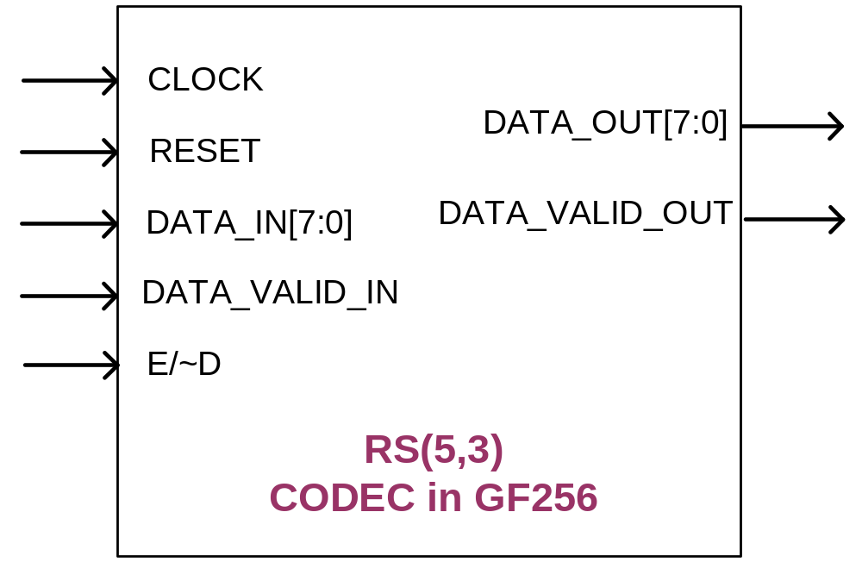
Functional Description-1/3

Slide 5
Functional Description-2/3
CLK : Positive Edge
RESET: Asynchronous Active LOW
DATA_IN[7:0] : Valid when DATA_VALID_IN is LOW.
Both message and codeword are fed to the CODEC from this port.
DATA_VALID_IN: Active LOW. Enables DATA_IN and E_D signals.
E_D :
  HIGH→Encoding
  LOW→Decoding

Slide 6
Functional Description-3/3
E_D is monitored during DATA_VALID_IN is LOW, therefore should be constant unless mode of operation is not to be changed.
DATA_OUT[7:0]: Output data. Valid when DATA_VALID_OUT is LOW.
DATA_VALID_OUT: Active LOW. Enables output data.

Slide 7
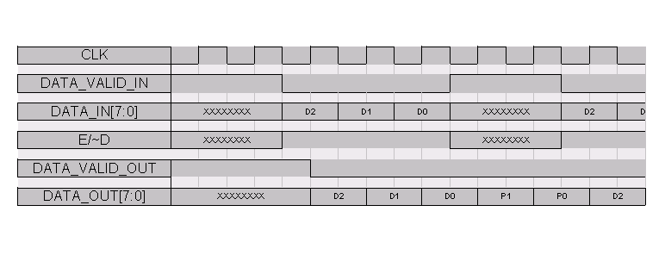
Functional Timing Waveform-1/7
ENCODING
Message symbols
Codeword symbols

Slide 8
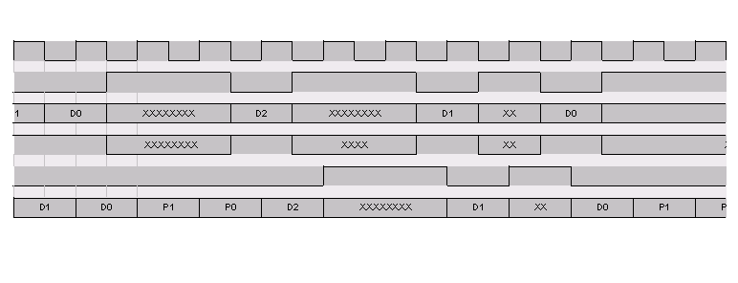
Functional Timing Waveform-2/7

Slide 9
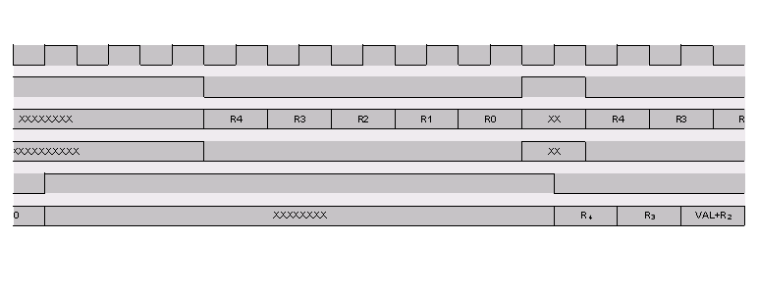
Functional Timing Waveform-3/7
Received vector
Decoded codeword

Slide 10
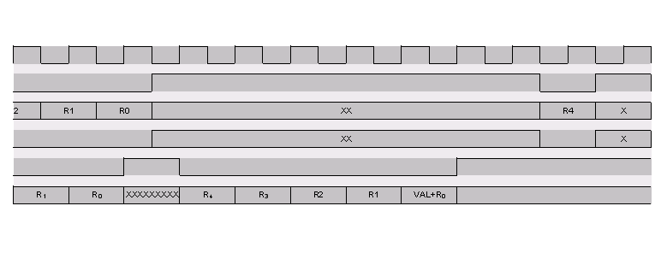
Functional Timing Waveform-4/7

Slide 11
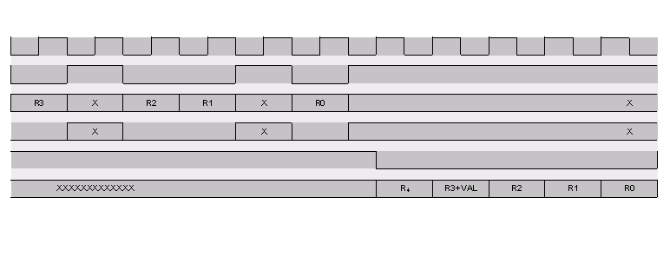
Functional Timing Waveform-5/7

Slide 12
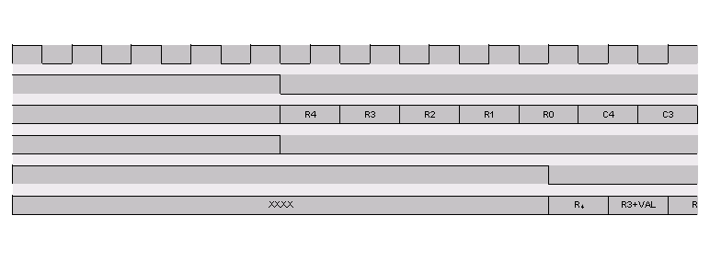
Functional Timing Waveform-6/7

Slide 13
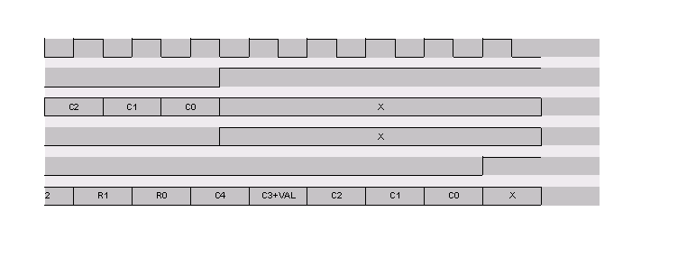
Functional Timing Waveform-7/7

Slide 14
Important Notes-1/3:
Encoding: After the message symbols are input, DATA_VALID_IN signal should be HIGH at the next two clock cycles.
Encoding/Decoding: E_D input is monitored at all clocks during DATA_VALID_IN is LOW. Therefore the change at this signal while DATA_VALID_IN is LOW means that the mode of operation (enc / dec) also changes.

Slide 15
Important Notes-2/3:
Constant E_D
Set two clock cycles after message is input

Slide 16
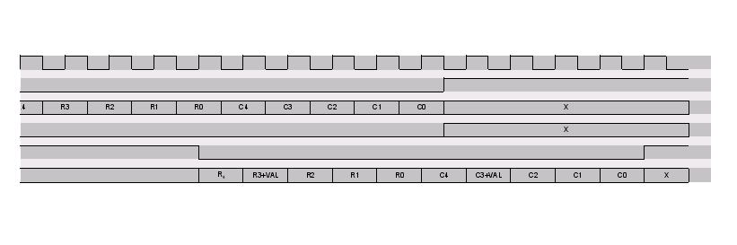
Important Notes-3/3:
Decoding: Decoding can be done successively via a pipelining method.
Another decoding begins

Slide 17
Functional Simulation-1/2
The following code words are decoded with all possible 1-error cases:
- [0 0 0 0 0] (all-zero code word)
- [1 1 1 153 152]
- [2 2 2 47 45]
- [3 3 3 182 181]
- [255 255 255 125 130]
- [20 30 40 94 124]

Slide 18
Functional Simulation-2/2
All possible message patterns are encoded and then decoded properly (assuming no error occurred).

Slide 19
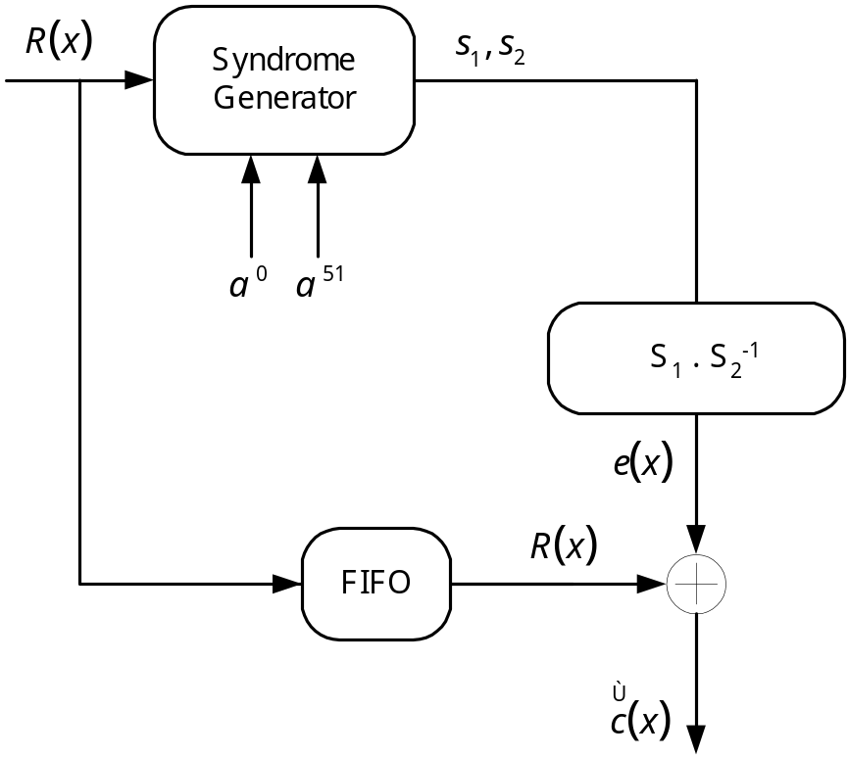
Technical Details-1/5
Methodology

Slide 20
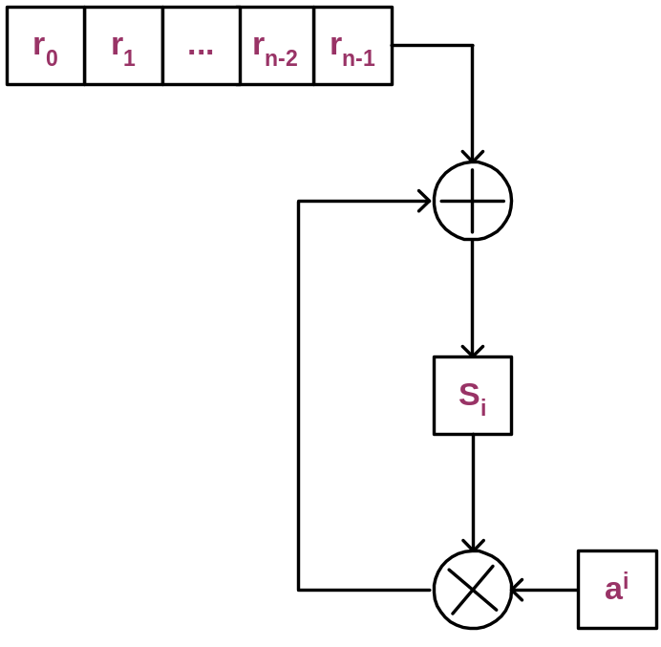
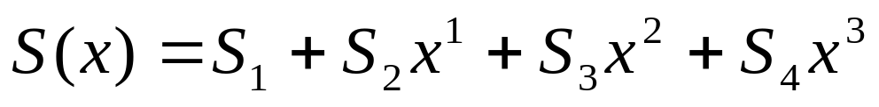
Technical Details-2/5
Syndrome Computation
S_{i}=R(α^{i}), and
R(α)=(…((r_{n-1}α+ r_{n-2}) α+ r_{n-3}) α…+ r₀)

Slide 21
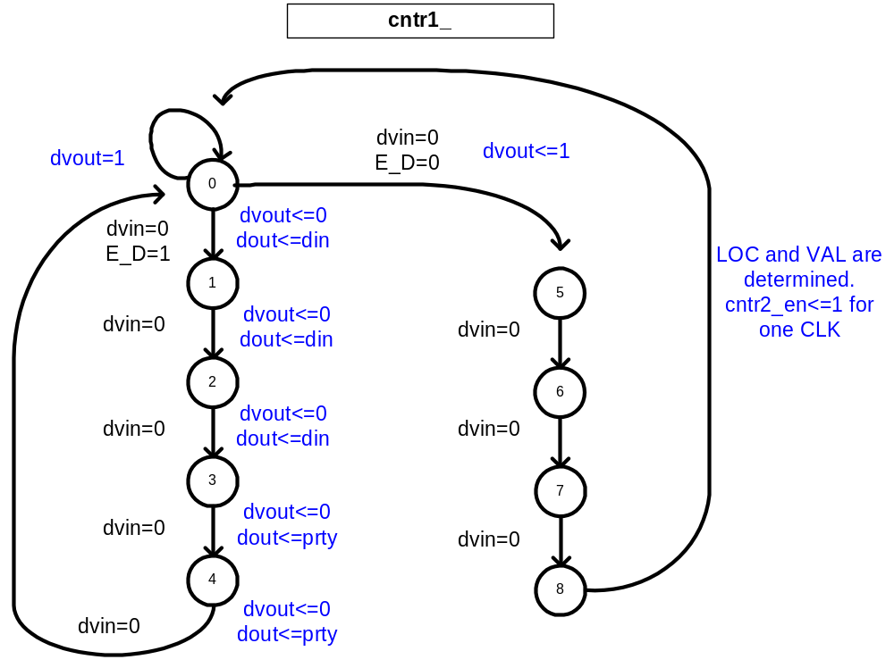
Technical Details-3/5

Slide 22
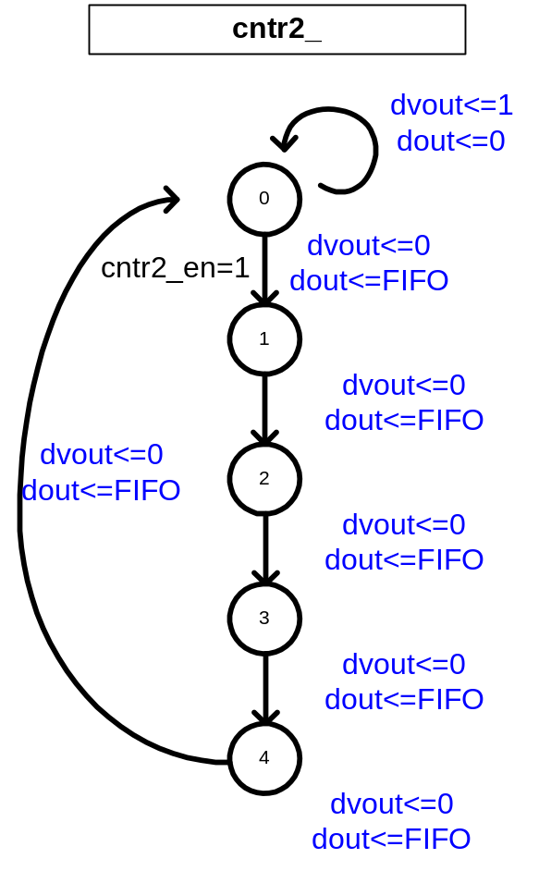
Technical Details-4/5

Slide 23
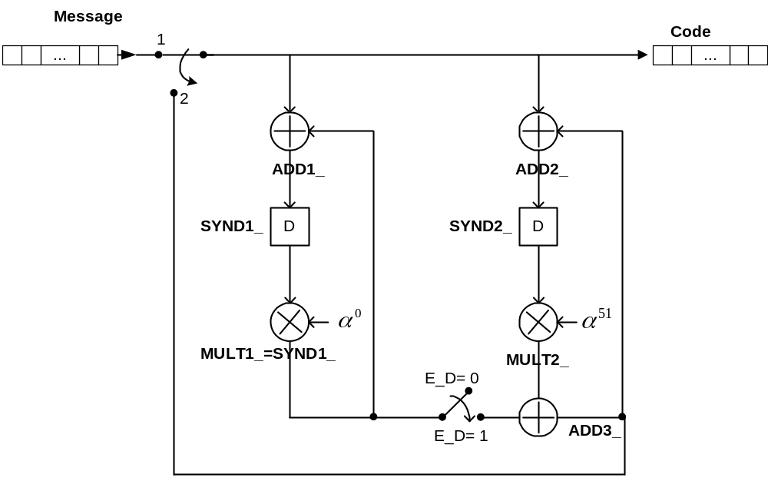
Technical Details-5/5

